Slide 1
Software Engineering
PRESENTATION
Group No:01

Slide 2
Question:
Implement Classical Modeling (Unified Modeling Language (UML)) and tools in process modeling such as Sequence and Activity diagrams.

Slide 3
We need to understand these terms:
Classical Modeling: Visual representation of software systems to understand and improve processes.
Unified Modeling Language (UML): Standardized visual modeling language used in software engineering.
Process Modeling: Visualizing steps, workflow, or interactions in a software process.
Tools in Process Modeling: Diagrams and software tools used to represent processes.

Slide 4
What is UML?
UML is a standard visual modeling language in software engineering (Booch, Rumbaugh, Jacobson, 2005).
UML helps create models for:
  Structure: Class Diagram, Component Diagram
  Behavior: Use Case Diagram, Activity Diagram, Sequence Diagram
  Interaction: Sequence Diagram

Slide 5
What is Process Modeling?
Process modeling visualizes the steps, workflow, or interactions in a system.
Helps developers and stakeholders understand, communicate, and improve processes.
Examples: E-commerce order processing
  User registration workflow
  Payment processing

Slide 6
Tools in Process Modeling
Sequence Diagram: Shows interactions between actors and system over time.
Activity Diagram: Shows workflow, branching, and decision points.
Use Case Diagram: Shows actors and their interactions with the system.

Slide 7
Steps to Implement Process Modeling
Step 1: Select a Process
Example: Online Order Processing in an e-commerce system
Step 2: Identify Actors and Components
Actors: Customer, Payment Gateway, Inventory System, Shipping System
Components: E-commerce application

Slide 8
Steps to implement continue…
Step 3: Create Diagrams
Sequence Diagram: Show interaction order
Activity Diagram: Show workflow and decision points
Use Case Diagram: Show actor interactions

Slide 9
Example – Sequence Diagram
Shows how actors and system components interact over time.
Example:
  Customer places order
  System checks inventory
  Payment Gateway processes payment
  Shipping system dispatches order

Slide 10
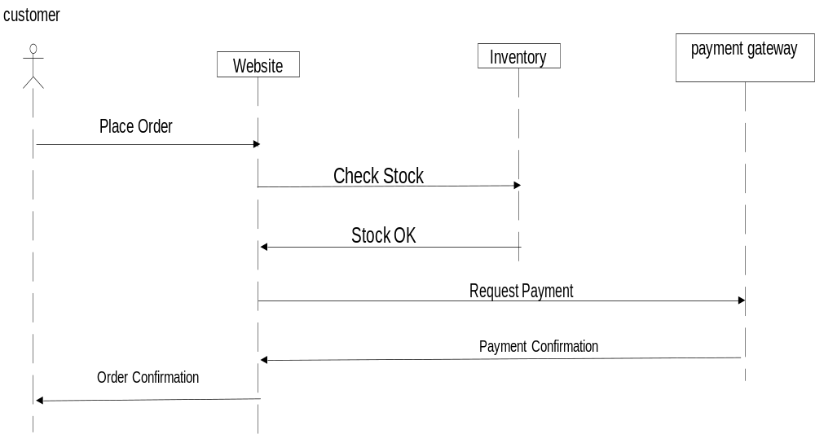
Steps to implement continue…

Slide 11
Example – Activity Diagram
Represents workflow of a process.
Example: Online Order Processing:
Start → Browse Products → Add to Cart → Checkout → Payment → Confirmation → End

Slide 12
